Slide 1
He II
J. G. Weisend II
www.europeanspallationsource.se
January 2017

Slide 2
Goals
Describe the physics and engineering of He II (superfluid helium)
Show some He II cooling options for large scale accelerators

Slide 3
He II (Superfluid Helium)
2nd liquid phase of helium (hence He II)
Phase transition is 2nd order (no latent heat) but there is a discontinuity in the specific heat (λ transition)
T_{λmax} = 2.2 K
Has unique thermal and fluid properties
  High effective thermal conductivity
  Zero viscosity under certain conditions

Slide 4
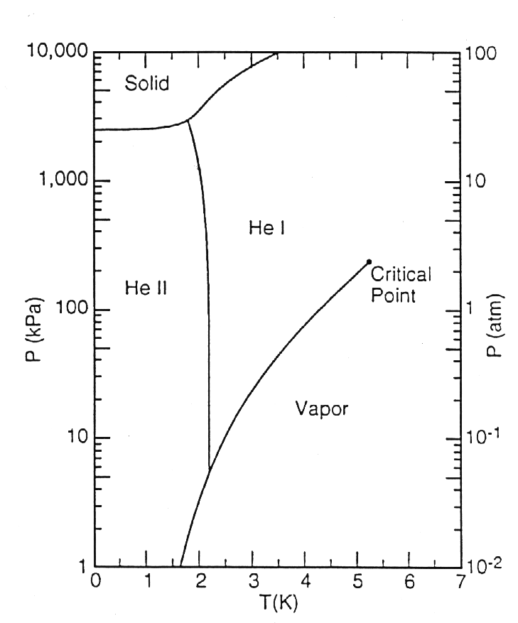
Helium Phase Diagram

Slide 5
Why use He II in Accelerator Systems?
The principal reason is the lower temperatures
Lower temperatures (< 2.2 K) allow:
  High critical fields and currents in superconducting magnets. This allows higher energy beams in existing tunnel geometries (LHC) Bending & Focusing the beam
  In SRF applications, lower temperatures mean lower surface resistance and thus more RF energy for beam acceleration and less for heating the cavity & helium Accelerating the beam
An additional advantage is the very efficient heat transfer mechanism in He II
  This results in no bulk boiling which reduces microphonics in SRF cavities

Slide 6
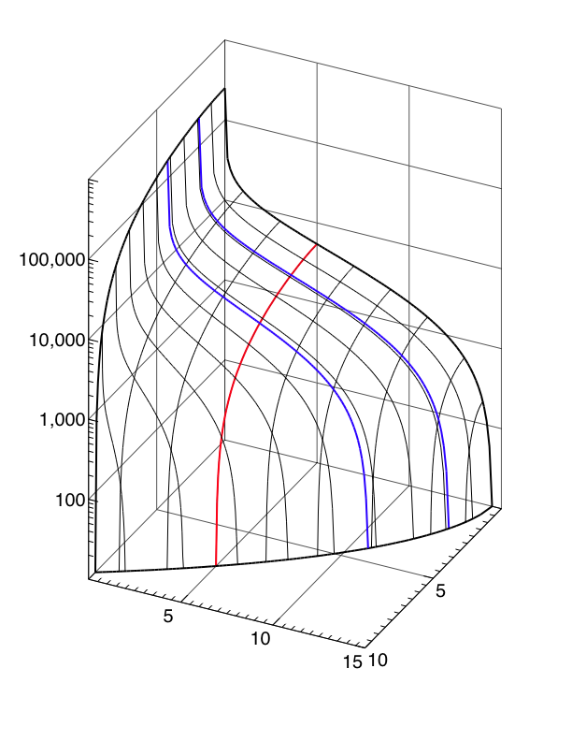
LHC NbTi Wire
J_{c} [A/mm²]
Courtesy L. Boturra of CERN
T=1.9 K
T=4.2 K
Note Improvement in B and Jc
@ T = 1.9 K
B = 5 [T]
100,000
10,000
1,000
100
B [T]
T [K]
5
5
Jc (5 T, 4.2 K) ≈ 3000 A/mm²
10
10
15

Slide 7
SRF Cavities: Surface Resistance, Frequency and Temperature
The RF surface resistance (which we want to minimize) of a SRF cavity is given by:
The surface resistance goes up with frequency and down with temperature: lower temperature equals less resistance, particularly at higher frequencies
He II refrigeration is more costly (due to Carnot & machine inefficiencies)
Generally speaking, removing 1 W at 2 K is the equivalent of removing 3 W at 4.2 K
What is the optimal temperature?
  Above about 500 – 700 MHz you win by operating below 4.2 K ( typically 1.8 – 2 K)
  At lower frequencies (e.g. 80 MHz) you are better at 4.2 K thermodynamically but there may be other considerations (FRIB)
  Between these limits it’s a fairly broad minimum. Most systems operate ~ 2 K – He II

Slide 8
What is He II ?
A “Bose – Einstein like” Condensate
  A fraction of atoms in He II have condensed to the quantum ground state
  He II was the first of these condensates discovered
  The only one that has significant industrial applications
The properties of He II can be understood via the two fluid model
  Note that a similar modeling approach is seen in superconductivity

Slide 9
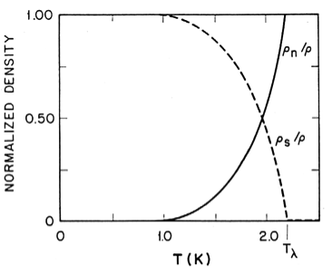
Two Fluid Model
He II can be thought of a fluid with two interpenetrating components:
  Normal fluid component
    Finite viscosity
    Finite entropy
  Superfluid component
    Zero viscosity
    Zero entropy
The interaction of these components can explain He II behavior
Relative Densities of Superfluid and Normal fluid components
(From Helium Cryogenics – Van Sciver)

Slide 10
Quantized Vortices
(or does He II at 1 K rotate in a bucket)
At 1 K He II is almost entirely the superfluid component and thus has almost 0 viscosity. This would imply that He at 1 K in a spinning bucket wouldn’t rotate but it does. What’s the answer?
  The vortices are quantized:
Solves rotating bucket problem
  In the body of the fluid:
  At the wall:
This has been experimentally observed
The quantized vortices in the superfluid component are an important part of heat transfer mechanism in He II

Slide 11
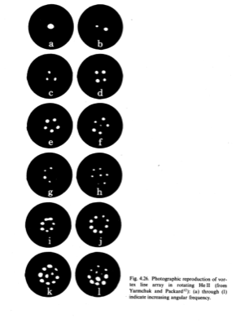
Direct Observation of Quantized Vortices via Electron Trapping

Slide 12
Heat Transfer in He II
The basic mechanism is internal convection:
No net mass flow
Note that this is not conduction or classical convection but an entirely different heat transfer mechanism
This can be extremely efficient (more than 1000x better than conduction through copper)
V _{n}
Q
V_{s}
T_{H}
T_{L}

Slide 13
Heat Transfer in He II
There are 2 heat transfer regimes:
  V_{s} < V _{sc}
  V_{s} > V _{sc}
    Mutual Friction Regime (quantized vortices interact with the viscosity of the normal component
As V _{sc} ~ d^{-1/4} (cgs units) the mutual friction regime is applicable in most engineering applications of He II

Slide 14
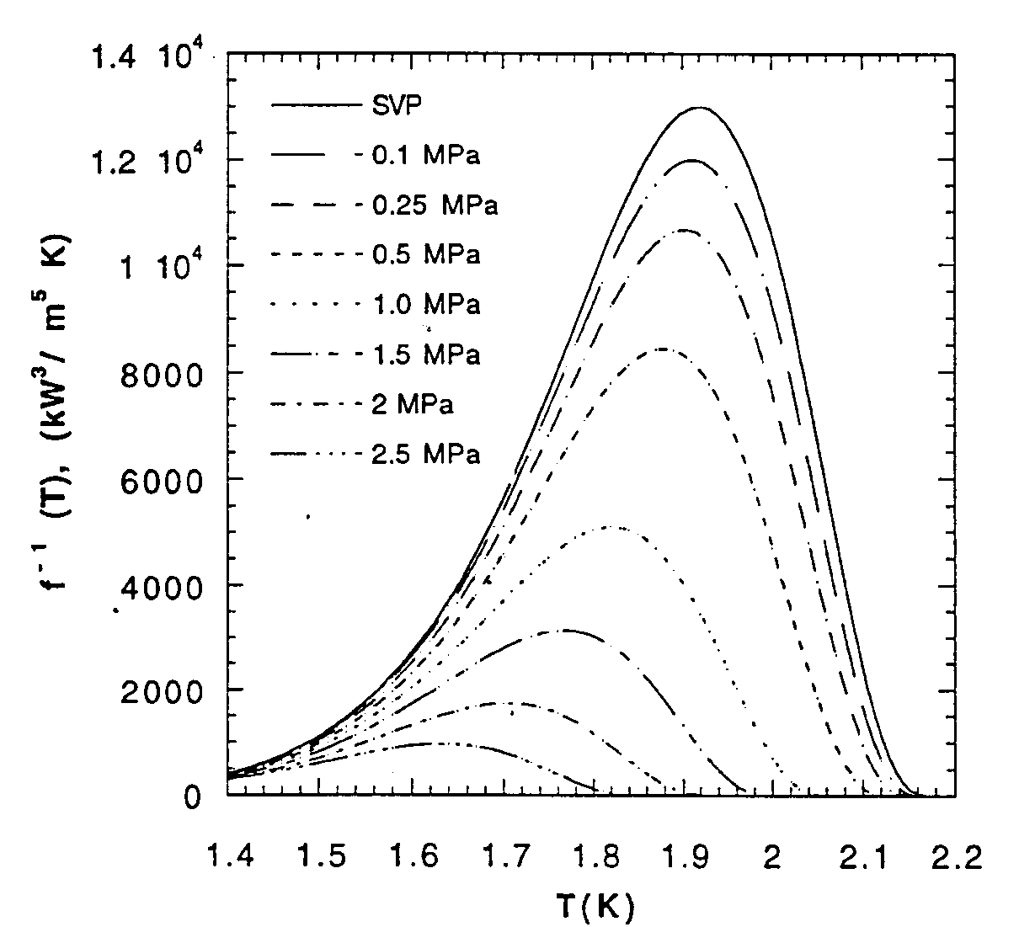
Heat Conductivity Function

Slide 15
He II Heat Transfer Limits
In pressurized He II: T _{h} must be less than T _{λ}
Thus the peak heat flux q* is:
At 1.9 K and 1 bar :
q*L^{1/3} ~ 15 kW/m^{5/3}

Slide 16
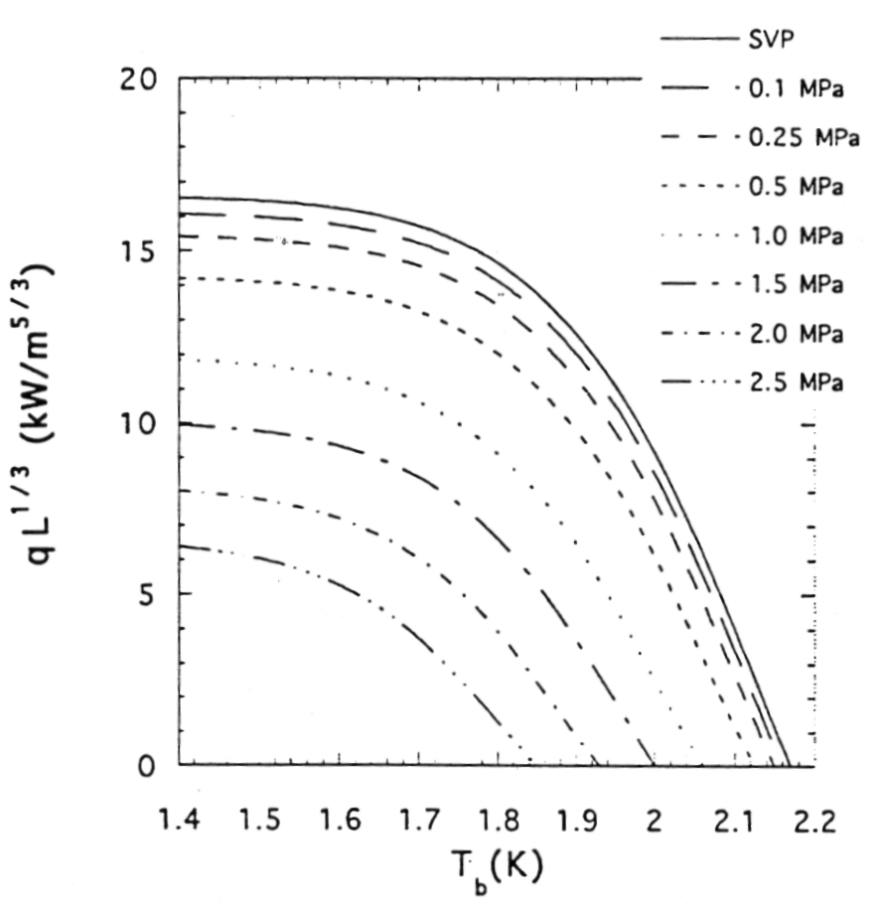
Peak Heat Flux (q*) in Pressurized He II

Slide 17
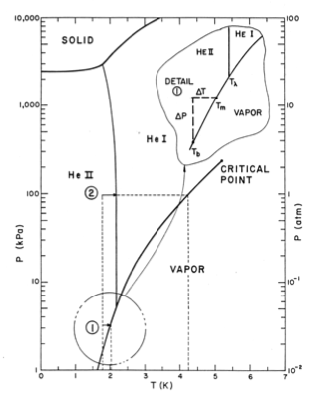
Limits on He II
Heat Transfer
In saturated He II, the limit is given by the local saturation temperature & the degree of local subcooling
In the ILC cavity He vessel this works out to about 1 W/cm² or ~ 30 W total through the connection tube
  More heat than that would require a redesign – LCLS II
Exceeding the heat transfer limits in either the saturated or pressurized case results in conversion to He I and boiling at the heated surface

Slide 18
Surface Heat Transfer
Heat transfer from a surface into He II is completely dominated by a fundamental inefficiency in moving energy from the surface to the fluid
This effect exists but is not important in standard convection problems
  Normally we assume T_{w} = T_{fw} but this is not true in the case of He II
This surface heat transfer effect is described by Kapitza Conductance
  For q < 1 kW/m²
  For q > 1 kW/m²
h _{k,} a and m are empirical and dependent on material, temperature and surface condition

Slide 19
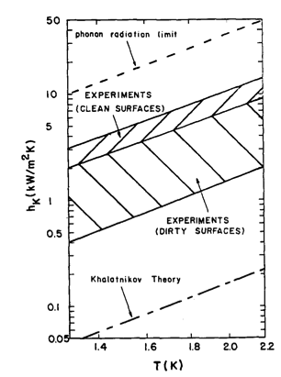
Surface Heat Transfer
m ~ 3
Kapitza conductance is not dependent on helium flow rate

Slide 20
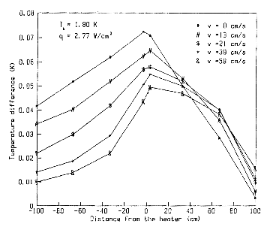
Forced Convection and He II
If Kapitza Conductance is independent of flow rate does forced convection in He II make any sense?
  Yes! Forced convection has the effect of reducing the maximum temperature in the He II and thus allowing more heat to be transferred before reaching the peak heat flux

Slide 21
He II Fluid Dynamics
Despite the presence of the superfluid component, in almost all engineering applications He II behaves as a classical fluid. This includes :
  Pump performance
    Except cavitation in saturated He II
  Pressure drop in tubes, valves, bellows and fittings
  Flow metering techniques
This is likely a result of the quantized vortices in the superfluid component being coupled via mutual friction to the normal fluid viscosity
However, keep in mind that the unique heat transfer properties still exist as described.

Slide 22
He II Fluid Dynamics
He II does behave differently in cases of:
  Film flow
  Porous plugs
  Two – phase flow (liquid/vapor) due to the large density difference between liquid and vapor in the case of He II

Slide 23
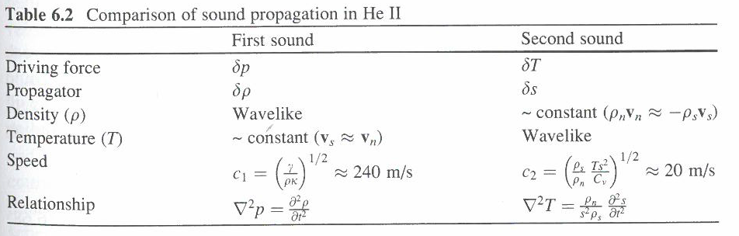
Second Sound
The two-fluid model predicts and experiments show that temperature waves may be established in the He II due to oscillations in the local entropy. These temperature waves are known as second sound as they are analogous to density waves caused by pressure oscillations.
Recall that the superfluid component has zero entropy
From Helium Cryogenics S.W. Van Sciver (2013)

Slide 24
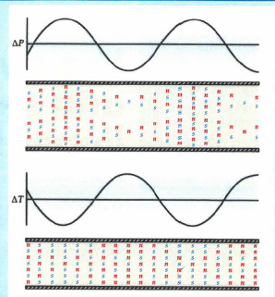
Second Sound
Second sound can be detected via
  thermometry (either time or flight or resonance techniques)
  Oscillating Superleak Transducers
Second sound is attenuated by mutual friction and has been used extensively quantum turbulence
More recently second sound has been used to locate quenches in SRF cavities
From Donnelly Physics Today October 2009

Slide 25
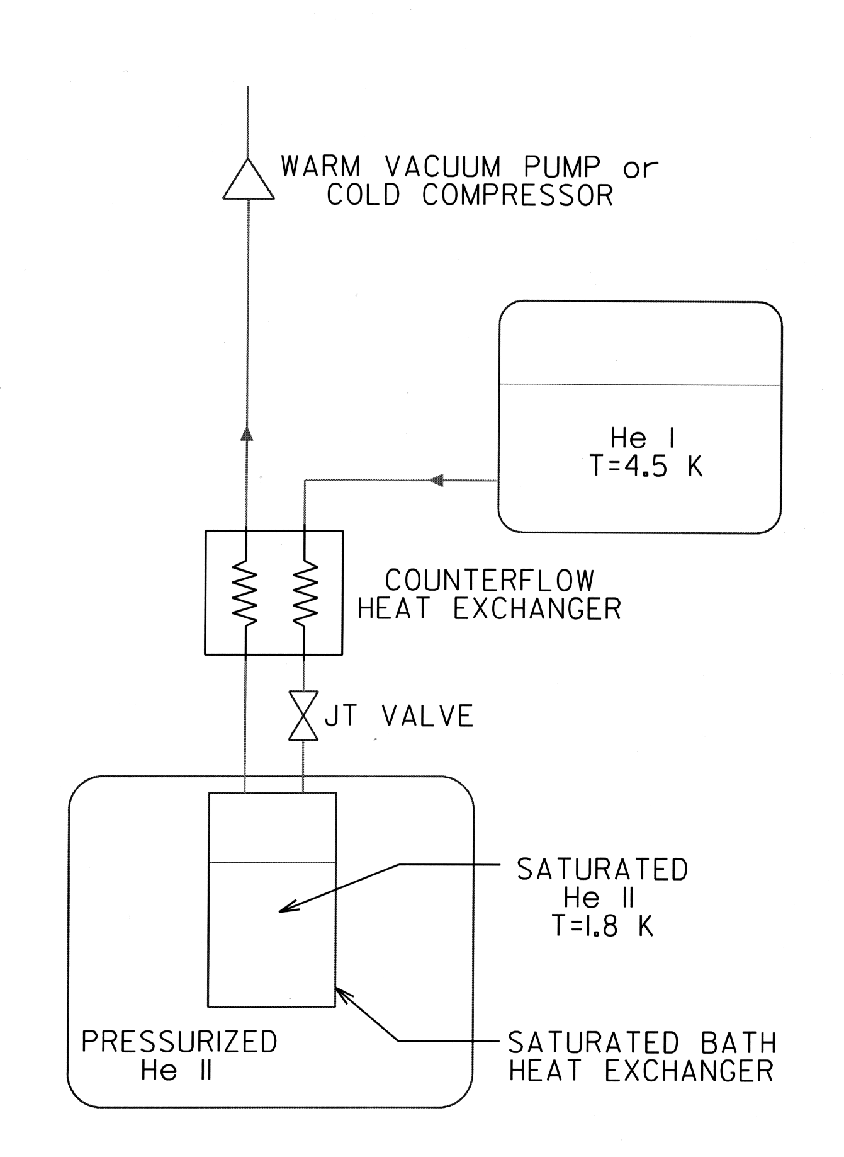
Typical He II
Refrigeration System
He II (Superfluid Helium) S. W. Van Sciver,
in Handbook of Cryogenic Engineering,
Note: This arrangement for a case in which pressurized He II is required - typically a S/C magnet application
For SRF systems, such an arrangement ends at the saturated He II bath
Internal convection is the heat transfer mechanism within the He II itself

Slide 26
He II Cooling in Large
Accelerator Systems
There are 2 general approaches to proving He II cooling in large accelerator systems
Discrete Cooling: He II is created at each individual cryomodule or magnet - A heat exchanger and JT valve exists at each component.
Advantages:
    Flexibility
    Lower overall heat leak to the He II space
Disadvantages:
    Cost
This approach is used in ESS, SNS, FRIB, 12 GeV

Slide 27
He II Cooling in Large
Accelerator Systems
Continuous Cooling: He II is created at a refrigerator or at the start of a string of components and then distributed to individual components.
Advantages:
    Less expensive
Disadvantages:
    Less flexibility
    More heat leak to the He II space
    May not be able to handle high heat loads in individual components
This approach is used in LHC, XFEL, ILC

Slide 28
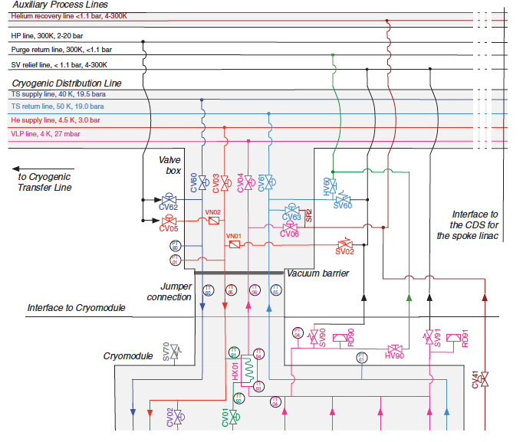
He II Cooling in
The European Spallation Source
(Discrete Cooling)
Each cryomodule has a dedicated
HX and JT valve

Slide 29



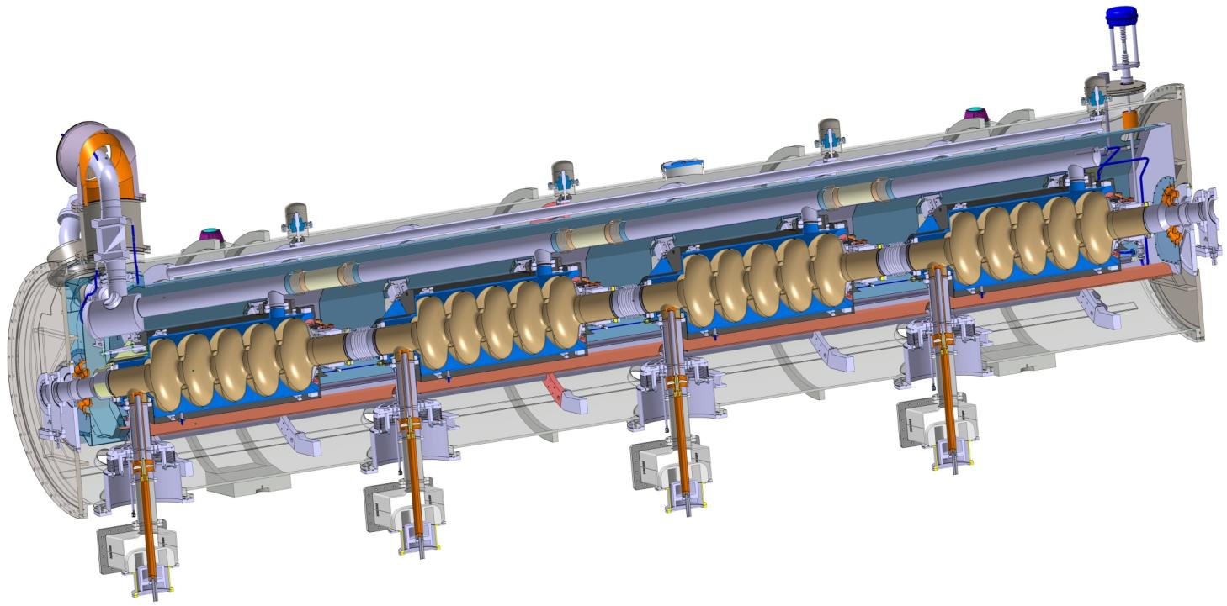
ESS
Elliptical Cavity Cryomodules
Similar to CEBAF/SNS cryomodule concept with 4 cavities per cryomodule
Common design for medium (6 cells) and high beta (5 cells) cavities
Regulation He valve
Thermal shielding
Alignement fiducial
Vacuum valve
Jumper connection
Magnetic shielding
Spaceframe support
Heat exchanger
Diphasic He pipe
Proton Beam
Cavity with Helium tank
Intercavities belows
Power coupler
Cold to warm transition

Slide 30
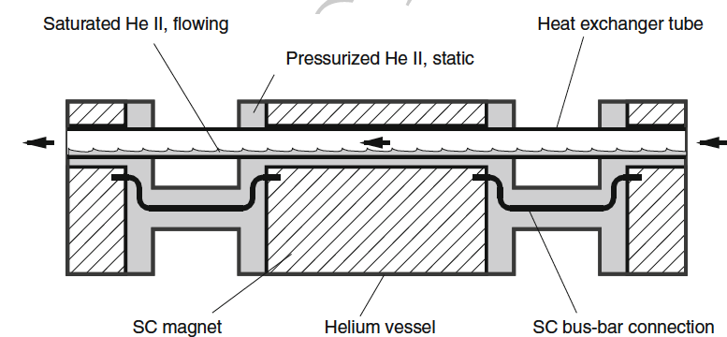
Large Hadron Collider
(Continuous Cooling)

Slide 31
Large Hadron Collider

Slide 32
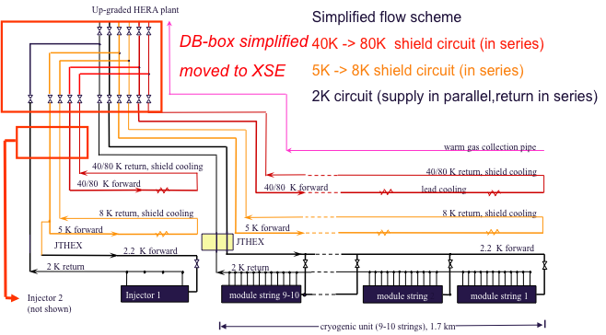
He II Cooling in
The European XFEL
(Continuous Cooling)

Slide 33
He II Cooling in LCLS II
LCLS-II uses a version of continuous cooling
  2/4 K heat exchanger at the at the distribution boxes in the start of each linac (upstream and downstream)
  Distribution of 2 K pressurized He throughout each linac
  Individual JT valves at each cryomodule
  Individual 2 phase lines at each cryomodule
  Shared low pressure gas return line in each linac
Why the difference?
  High dynamic heat loads in each cryomodule and tunnel slope make this an optimum solution
    Otherwise, very large flows of two-phase He II would be required
    Tunnel slope makes individual 2 phase lines at each cryomodule desirable

Slide 34
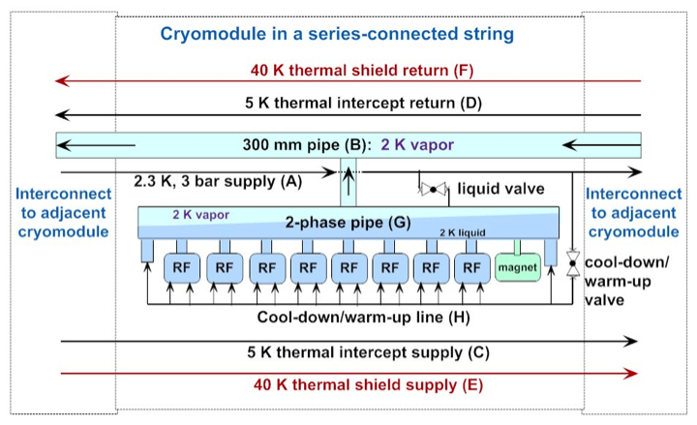
He II Cooling in LCLS II

Slide 35
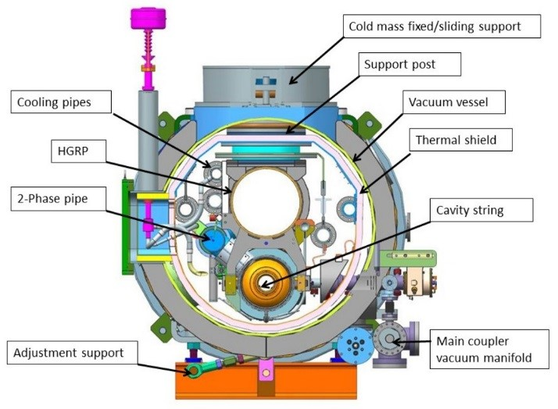
Cross Section of LCLS II
Cryomodule
Changes from ILC/XFEL design
Larger 2 He II Chimney
Larger HGRP
Individual JT and Cooldown valves
No 5 K thermal shield
  Higher heat load
  Fewer cryomodules

Slide 36
He II Summary
He II is a unique fluid that displays quantum behavior on a macroscopic scale
He II has significant applications in large scale cryogenics for scientific research & has become the most common approach for cooling SRF systems
Depending on requirements, a number of different cooling arrangements exist for SRF systems
  All start with internal convection within the He II bath
Despite its unique properties, the use of He II in industrial scale engineering applications is well understood and significant experience exists: ESS, LHC, Jlab, LCLS II

